Slide 1

Fundamentals of Cryptography
ASHRAF MASOOD
dean@mcs.edu.pk
Lecture Slides – BESE16B- Spring 2013- Lecture Set #2

Slide 2
Classical Cryptography

Slide 3
Things to Remember (Again & Again)!
Cryptography is:
A tremendous tool
The basis for many security mechanisms
Cryptography is not:
The solution to all security problems
Reliable unless implemented and used properly
Something you should not try to invent yourself
many many examples of broken ad-hoc designs

Slide 4
Cryptography: A Rigorous Science
The three steps in cryptography:
Precisely specify threat model
Propose a construction
Prove that breaking construction under threat mode will solve an underlying hard problem
Notes:
Example: define what it means to forge signatures, give construction, show that forging signatures is as hard as factoring.

Slide 5
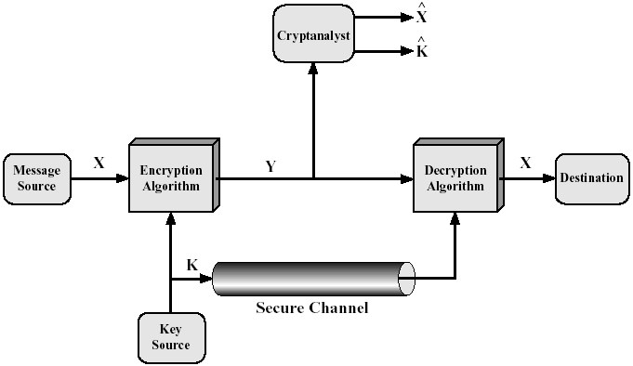
Conventional Cryptosystem Model
Conventional
Secret-Key (⇔ Public-Key)
Single-Key (⇔ Two-Key)
Symmetric (⇔ Asymmetric)
Requirements
Strong encryption algorithm
Share of the secret key in a
secure fashion

Slide 6
Cryptosystem
A cryptosystem is a five-tuple (P, C, K, E, D), where following
conditions are satisfied :
P is a finite set of possible plaintexts
C is a finite set of possible ciphertexts
K, the keyspace, is a finite set of possible keys
For each K ∈ K, there is an encryption algorithm E_{K} ∈ E and a corresponding decryption algorithm D_{K} ∈ D. Each E_{K} : P → C and D_{K} : C → P are functions such that D_{K}(E_{K}(X)) = X for every plaintext X ∈ P.

Slide 7
Kerchhoff’s Principle
“Encryption algorithms being used should be assumed to be publicly known and the security of the algorithm should reside only in the key chosen”

Slide 8
Classical Cryptography
Started with more of a steganography than Cryptography (being an art than a science).
Prior to machines, manual cryptography involved one operation out of substitution, transposition or permutation (simple scientific functions)
Prior to computers, mechanical/electromechanical machines implemented one layer of SP network (mix of art & science)
Post WW-II, computer based machines implemented multi-layered SP network
Public-key cryptography revolutionized the cryptography

Slide 9
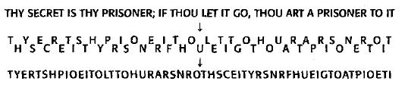
Transposition Cipher
Transposition ciphers jumble the letters of the message in a way that is designed to confuse the attacker, but can be un-jumbled by the intended recipient.

Slide 10
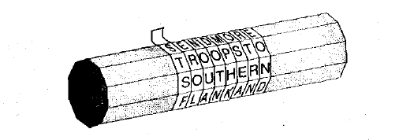
Transposition Cipher
One of the earliest recorded uses of cryptography was the Spartan scytale (circa 500 B.C.). A thin strip of parchment was wrapped helically around a cylindrical rod and the message was written across the rod, with each letter on a successive turn of the parchment. The strip was unwound and delivered to the receiver. The message could then be decrypted with the use of an identical cylindrical rod.

Slide 11
The Permutation Cipher
It was described in book by Giovanni Porta written in 1563.

Slide 12
The Permutation Cipher
In order to use the cipher a permutation has to be defined. Let us use the following permutation as example:
Since m = 6, the original message has to be broken on n groups of six letters each. If last group is shorter, necessary number of dummy letters can be appended to the end.
Each group is rearranged according to the permutation defined previously.
To decrypt a ciphertext message inverse permutation should be applied in a similar way.
x | 1 | 2 | 3 | 4 | 5 | 6
π(x) | 5 | 1 | 6 | 3 | 2 | 4
c | 1 | 2 | 3 | 4 | 5 | 6
π⁻¹(c) | 2 | 5 | 4 | 6 | 1 | 3

Slide 13
Example: The Permutation Cipher
Suppose m=6, and the key is the following permutation π:
x | 1 | 2 | 3 | 4 | 5 | 6
π(x) | 3 | 5 | 1 | 6 | 4 | 2
Now suppose we are given the plaintext:
shesellsseashellsbytheseashore
We first partition it into a group of 6:
shesel lsseas hellsb ythese ashore
Now each group of 6 letters is rearranged according to the permutation table π:
EESLSH SALSES LSHBLE HSYEET HRAEOS
This is ciphertext, which can be decrypted in a similar fashion using inversion permutation π⁻¹
x | 1 | 2 | 3 | 4 | 5 | 6
Π⁻¹(x) | 3 | 6 | 1 | 5 | 2 | 4

Slide 14
Classical Cryptosystems
Mono-alphabetic Ciphers

Slide 15
Touching the math a bit!
The integer modulo m, denoted by Zm is the set of integers {0,1,2,..,m-1} where addition, subtraction and multiplication is performed modulo m.
Examples: Z25 ≡ {0,1,2,…..,24}
In Z25,
13 + 16 =4, since 13+16=29≡4 (mod 25)
Similarly
In Z25,
13.16 =8, since 13.16=208≡8 (mod 25)

Slide 16
Monoalphabetic Ciphers
The ciphers for which, once a key is chosen, each alphabetic character is mapped to a unique alphabetic character
Examples of mono alphabetic ciphers include:
Transposition Cipher
Shift cipher
Substitution Cipher
Affine cipher

Slide 17
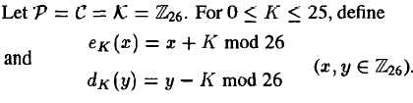
Shift Cipher
We first convert the plaintext string into integers. The rule is:
a<->0, b<->1, c<->2, d<->3, e<->4, f<->5, g<->6, h<->7, i<->8, j<->9, k<->10, l<->11, m<->12,n<->13, o<->14, p<->15,q<->16, r<->17, s<->18, t<->19, u<->20, v<->21, w<->22, x<->23, y<->24, z<->25

Slide 18
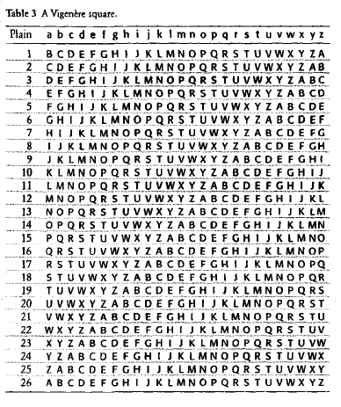
The Shift Cipher Table

Slide 19
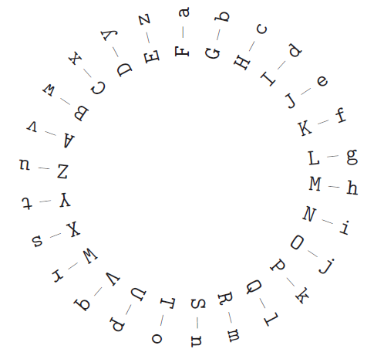
Cipher wheel

Slide 20
Shift Cipher
Example
Let plaintext (p) =
We will meet at mid night
w | e | w | i | l | l | m | e | e | t | a | t | m | i | d | n | i | g | h | t
22 | 4 | 22 | 8 | 11 | 11 | 12 | 4 | 4 | 19 | 0 | 19 | 12 | 8 | 3 | 13 | 8 | 6 | 7 | 19
Let K=11, we add 11 to each value, reducing each sum modulo 26, we get ciphertext
7 | 15 | 7 | 19 | 22 | 22 | 23 | 15 | 15 | 4 | 11 | 4 | 23 | 19 | 14 | 24 | 19 | 17 | 18 | 4
H | P | H | T | W | W | X | P | P | E | L | E | X | T | O | Y | T | R | S | E

Slide 21
Shift Cipher
For a particular Key k=3, the cryptosystem is often called the
Caesar Cipher (Roman Empire, 2000 years ago )
0123456...
Plain: abcdefghijklmnopqrstuvwxyz
Cipher: DEFGHIJKLMNOPQRSTUVWXYZABC
3456789...
Plain: meet me after the toga party
Cipher: PHHW PH DIWHU WKH WRJD SDUWB

Slide 22
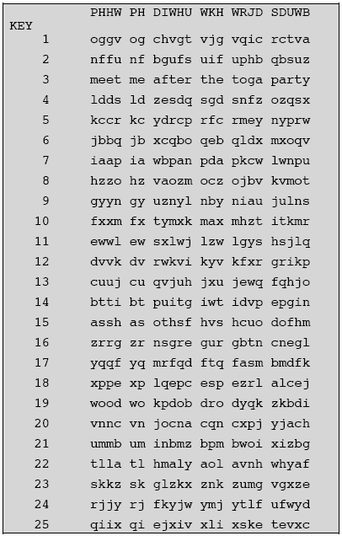
Cryptanalysis of Shift Cipher
Shift cipher (modulo 26) is not secure, since it can be cryptanalyzed by brute force attack
There are only 25 keys to try, until a meaningful plaintext string is obtained
On average, a plaintext will be computed using 26/2=13 decryption rule

Slide 23
The Substitution Cipher
Example:
Plaintext: s u b s t i t u t i o n
Ciphertext: V U N V M Z M U M Z F S

Slide 24
Cryptanalysis of The Substitution Cipher
A key in substitution cipher consist of a permutation of 26 alphabetic characters
There are 26! = ~4 x 10E26 possible keys
Exhaustive key search is infeasible
Simple substitution ciphers were considered strong for many centuries
The first ever published description of how to crack simple substitution ciphers was given by Arab/Iraqi scientist Abu Yusuf Yaqub ibn Ishaq al-Kindi in A Manuscript on Deciphering Cryptographic Messages written around 850 CE
The method he described is now known as Frequency Analysis

Slide 25
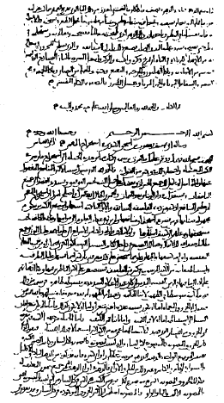
Muslims’ Contribution in Frequency Analysis Cryptanalysis
The first page of Al-Kindi's manuscript On Deciphering Cryptographic Messages, containing the oldest known description of cryptanalysis by frequency analysis.
This attack relies on the fact that statistical information that is present in the plaintext language “leaks” through a simple substitution.

Slide 26
Frequency Analysis
The statistical distribution of letter frequencies of a message (text) written in any language tend towards a known letter frequency distribution profile of the language.
This is particularly true for long messages (i.e., the longer the text, the closer the letter frequency distributions match the language’s letter frequency distributions)
The simple substitution cipher preserves the letter frequency distributions of the plaintext in the ciphertext (i.e., information about the plaintext is leaked in the ciphertext)

Slide 27
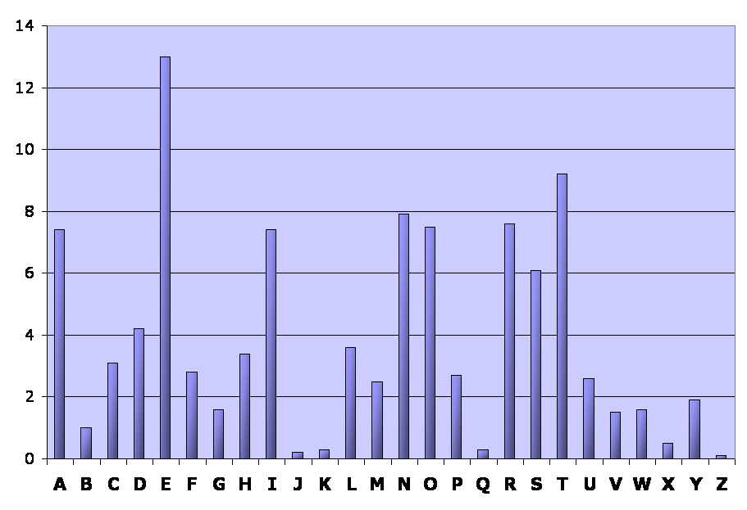
English Language: Relative Letter Frequencies
Letter | A | B | C | D | E | F | G | H | I | J | K | L | M
Frequency | 7.4 | 1.0 | 3.1 | 4.2 | 13.0 | 2.8 | 1.6 | 3.4 | 7.4 | 0.2 | 0.3 | 3.6 | 2.5
Letter | N | O | P | Q | R | S | T | U | V | W | X | Y | Z
Frequency | 7.9 | 8.0 | 2.7 | 0.3 | 8.0 | 6.1 | 9.2 | 2.6 | 1.5 | 1.6 | 0.5 | 1.9 | 0.1

Slide 28
Example: Cryptanalysis, The Substitution Cipher
Ciphertext:
R jrk hbxiu lk vai vzihova ohlls lo rk rmrsvjikv ywbhtbkn. Ixise jlskbkn ai vrgiu vai ihixrvls tlzk vl vai hlyye rkt hirxiu vai ywbhtbkn. Bk vai ixikbkn, ai nivu bkvl vai ihixrvls, rkt, bo vaisi bu uljilki ihui bk vai ihixrvls -- ls bo bv zru srbkbkn varv tre -- ai nliu yrpg vl abu ohlls tbsipvhe. Alzixis, bo vaisi bu klylte ihui bk vai ihixrvls rkt bv aruk'v srbkit, ai nliu vl vai vikva ohlls rkt zrhgu wm vzl ohbnavu lo uvrbsu vl abu sllj.
Letter frequency count (total = 344 letters):
Letter | A | B | C | D | E | F | G | H | I | J | K | L | M
Frequency | 23 | 26 | 0 | 0 | 5 | 0 | 3 | 18 | 49 | 5 | 26 | 32 | 2
Letter | N | O | P | Q | R | S | T | U | V | W | X | Y | Z
Frequency | 9 | 10 | 2 | 0 | 24 | 19 | 11 | 19 | 37 | 3 | 9 | 6 | 6

Slide 29
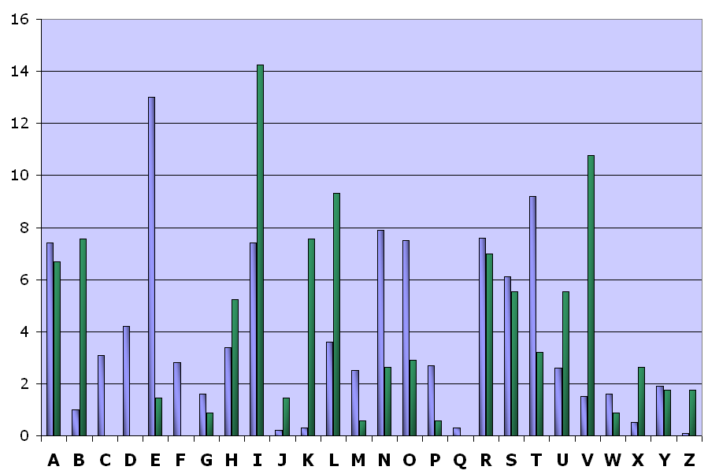
Example: Cryptanalysis, The Substitution Cipher (cont …)

Slide 30
Example: Cryptanalysis, The Substitution Cipher (cont …)
From the frequency distributions, we assume that:
C(I) -> P(E) matching relative frequencies
C(V) -> P(T) matching relative frequencies
Partially decrypted ciphertext (red = plaintext):
R jrk hbxeu lk vae vzehova ohlls lo rk rmrsvjekv ywbhtbkn. Exese jlskbkn ae vrgeu vae ehexrvls tlzk vl vae hlyye rkt herxeu vae ywbhtbkn. Bk vae exekbkn, ae nevu bkvl vae ehexrvls, rkt, bo vaese bu uljelke ehue bk vae ehexrvls -- ls bo bv zru srbkbkn varv tre -- ae nleu yrpg vl abu ohlls tbsepvhe. Alzexes, bo vaese bu klylte ehue bk vae ehexrvls rkt bv aruk'v srbket, ae nleu vl vae vekva ohlls rkt zrhgu wm vzl ohbnavu lo uvrbsu vl abu sllj.

Slide 31
Example: Cryptanalysis, The Substitution Cipher (cont …)
Digram frequencies
Common digraphs: EN, RE, ER, NT, TH
Trigram frequencies
Common trigrams: THE, ING, THA, ENT
Vowels other than E are rarely followed by another vowel
The letter Q is followed only by U

Slide 32
Example: Cryptanalysis, The Substitution Cipher (cont …)
From the frequency distributions, we assume that:
C(A) -> P(H)
The digram ‘TH’ is the most common in the English language
The word “THE” is the only frequently used 3-letter English word starting with T and ending with E
Partially decrypted ciphertext (red = plaintext):
R jrk hbxeu lk vae vzehova ohlls lo rk rmrsvjekv ywbhtbkn. Exese jlskbkn ae vrgeu vae ehexrvls tlzk vl vae hlyye rkt herxeu vae ywbhtbkn. Bk vae exekbkn, ae nevu bkvl vae ehexrvls, rkt, bo vaese bu uljelke ehue bk vae ehexrvls -- ls bo bv zru srbkbkn varv tre -- ae nleu yrpg vl abu ohlls tbsepvhe. Alzexes, bo vaese bu klylte ehue bk vae ehexrvls rkt bv aruk'v srbket, ae nleu vl vae vekva ohlls rkt zrhgu wm vzl ohbnavu lo uvrbsu vl abu sllj.

Slide 33
Example: Cryptanalysis, The Substitution Cipher (cont …)
From the frequency distributions, we assume that:
C(A) -> P(H)
The digram ‘TH’ is the most common in the English language
The word “THE” is the only frequently used 3-letter English word starting with T and ending with E
Partially decrypted ciphertext (red = plaintext):
R jrk hbxeu lk the tzehoth ohlls lo rk rmrstjekt ywbhtbkn. Exese jlskbkn he trgeu the ehexrtls tlzk tl the hlyye rkt herxeu the ywbhtbkn. Bk the exekbkn, he netu bktl the ehexrtls, rkt, bo these bu uljelke ehue bk the ehexrtls -- ls bo bt zru srbkbkn thrt tre -- he nleu yrpg tl hbu ohlls tbsepthe. hlzexes, bo these bu klylte ehue bk the ehexrtls rkt bt hruk't srbket, he nleu tl the tekth ohlls rkt zrhgu wm tzl ohbnhtu lo utrbsu tl hbu sllj.

Slide 34
Example: Cryptanalysis, The Substitution Cipher (cont …)
We can assume that C(R) -> P(A) because:
The word “THAT” is the only frequently used 4-letter English word starting with ‘TH’ and ending with T
C(R) -> P(A) matching relative frequencies
Partially decrypted ciphertext (red = plaintext):
R jrk hbxeu lk the tzehoth ohlls lo rk rmrstjekt ywbhtbkn. Exese jlskbkn he trgeu the ehexrtls tlzk tl the hlyye rkt herxeu the ywbhtbkn. Bk the exekbkn, he netu bktl the ehexrtls, rkt, bo these bu uljelke ehue bk the ehexrtls -- ls bo bt zru srbkbkn thrt tre -- he nleu yrpg tl hbu ohlls tbsepthe. hlzexes, bo these bu klylte ehue bk the ehexrtls rkt bt hruk't srbket, he nleu tl the tekth ohlls rkt zrhgu wm tzl ohbnhtu lo utrbsu tl hbu sllj.

Slide 35
Example: Cryptanalysis, The Substitution Cipher (cont …)
We can assume that C(R) -> P(A) because:
The word “THAT” is the only frequently used 4-letter English word starting with ‘TH’ and ending with T
C(R) -> P(A) matching relative frequencies
Partially decrypted ciphertext (red = plaintext):
A jak hbxeu lk the tzehoth ohlls lo ak amastjekt ywbhtbkn. Exese jlskbkn he tageu the ehexatls tlzk tl the hlyye akt heaxeu the ywbhtbkn. Bk the exekbkn, he netu bktl the ehexatls, akt, bo these bu uljelke ehue bk the ehexatls -- ls bo bt zau sabkbkn that tae -- he nleu yapg tl hbu ohlls tbsepthe. hlzexes, bo these bu klylte ehue bk the ehexatls akt bt hauk't sabket, he nleu tl the tekth ohlls akt zahgu wm tzl ohbnhtu lo utabsu tl hbu sllj.

Slide 36
Example: Cryptanalysis, The Substitution Cipher (cont …)
We can assume that C(K) -> P(N) because:
The words “AN” and “AT” are the only frequently used 2-letter English words starting with A
The relative frequency of K in the ciphertext closely approximates the relative frequency of N in English
Partially decrypted ciphertext (red = plaintext):
A jak hbxeu lk the tzehoth ohlls lo ak amastjekt ywbhtbkn. Exese jlskbkn he tageu the ehexatls tlzk tl the hlyye akt heaxeu the ywbhtbkn. Bk the exekbkn, he netu bktl the ehexatls, akt, bo these bu uljelke ehue bk the ehexatls -- ls bo bt zau sabkbkn that tae -- he nleu yapg tl hbu ohlls tbsepthe. hlzexes, bo these bu klylte ehue bk the ehexatls akt bt hauk't sabket, he nleu tl the tekth ohlls akt zahgu wm tzl ohbnhtu lo utabsu tl hbu sllj.

Slide 37
Example: Cryptanalysis, The Substitution Cipher (cont …)
We can assume that C(K) -> P(N) because:
The words “AN” and “AT” are the only frequently used 2-letter English words starting with A
The relative frequency of K in the ciphertext closely approximates the relative frequency of N in English
Partially decrypted ciphertext (red = plaintext):
A jan hbxeu ln the tzehoth ohlls lo an amastjent ywbhtbnn. Exese jlsnbnn he tageu the ehexatls tlzn tl the hlyye ant heaxeu the ywbhtbnn. Bn the exenbnn, he netu bntl the ehexatls, ant, bo these bu uljelne ehue bn the ehexatls -- ls bo bt zau sabnbnn that tae -- he nleu yapg tl hbu ohlls tbsepthe. hlzexes, bo these bu nlylte ehue bn the ehexatls ant bt haun't sabnet, he nleu tl the tenth ohlls ant zahgu wm tzl ohbnhtu lo utabsu tl hbu sllj.

Slide 38
Example: Cryptanalysis, The Substitution Cipher (cont …)
We assume that:
C(T) -> P(D) (from the word ‘ant’)
C(B) -> P(I) (from the words ‘bt’ and ‘bn’)
Partially decrypted ciphertext (red = plaintext):
A jan hbxeu ln the tzehoth ohlls lo an amastjent ywbhtbnn. Exese jlsnbnn he tageu the ehexatls tlzn tl the hlyye ant heaxeu the ywbhtbnn. Bn the exenbnn, he netu bntl the ehexatls, ant, bo these bu uljelne ehue bn the ehexatls -- ls bo bt zau sabnbnn that tae -- he nleu yapg tl hbu ohlls tbsepthe. hlzexes, bo these bu nlylte ehue bn the ehexatls ant bt haun't sabnet, he nleu tl the tenth ohlls ant zahgu wm tzl ohbnhtu lo utabsu tl hbu sllj.

Slide 39
Example: Cryptanalysis, The Substitution Cipher (cont …)
We assume that:
C(T) -> P(D) (from the word ‘ant’)
C(B) -> P(I) (from the words ‘bt’ and ‘bn’)
Partially decrypted ciphertext (red = plaintext):
A jan hbxeu ln the tzehoth ohlls lo an amastjent ywbhdbnn. Exese jlsnbnn he tageu the ehexatls dlzn tl the hlyye and heaxeu the ywbhdbnn. Bn the exenbnn, he netu bntl the ehexatls, and, bo these bu uljelne ehue bn the ehexatls -- ls bo bt zau sabnbnn that tae -- he nleu yapg tl hbu ohlls tbsepthe. hlzexes, bo these bu nlylte ehue bn the ehexatls and bt haun't sabned, he nleu tl the tenth ohlls and zahgu wm tzl ohbnhtu lo utabsu tl hbu sllj.

Slide 40
Example: Cryptanalysis, The Substitution Cipher (cont …)
We assume that:
C(T) -> P(D) (from the word ‘ant’)
C(B) -> P(I) (from the words ‘bt’ and ‘bn’)
Partially decrypted ciphertext (red = plaintext):
A jan hixeu ln the tzehoth ohlls lo an amastjent ywihdbnn. Exese jlsnbnn he tageu the ehexatls dlzn tl the hlyye and heaxeu the ywbhdbnn. In the exeninn, he netu intl the ehexatls, and, io these iu uljelne ehue in the ehexatls -- ls io it zau saininn that tae -- he nleu yapg tl hiu ohlls tisepthe. hlzexes, io these iu nlylte ehue in the ehexatls and it haun't sabned, he nleu tl the tenth ohlls and zahgu wm tzl ohinhtu lo utabsu tl hiu sllj.

Slide 41
Example: Cryptanalysis, The Substitution Cipher (cont …)
If you continue like this, you will eventually obtain a complete decryption of the message and will also have recovered the key (the substitution alphabet)
The substitution alphabet for this example is:
p :ABCDEFGHIJKLMNOPQRSTUVWXYZ
F_{k}(p) :RYPTIONABFGHJKLMQSUVWXZDEC

Slide 42
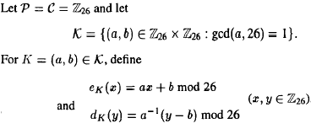
The Affine Cipher

Slide 43
Example: The Affine Cipher
Suppose K=(7,3), the encryption formula becomes:
e_{K} (x)=7*x + 3 mod 26
Example: Encrypt “ hot” ⬄ 7, 14, 19
(7 x 7 + 3) mod 26 = 52 mod 26 = 0
(7x14 + 3) mod 26 =101 mod 26=23
(7x19 + 3) mod 26 -= 136 mod 26=6
0,23,6 ⬄ AXG

Slide 44
Example: The Affine Cipher
Since K=(7,3), We can calculate 7⁻¹ mod 26=15, the corresponding decryption function is
d_{k}(y)= 15 (y-3) = 15 y - 19

Slide 45
The Affine Cipher
This congruence has a unique solution for every y if and only if gcd(a, 26) = 1
WHY??
The values of such that gcd(a, 26) = 1 are
a = 1, 3, 5, 7, 9, 11, 15, 17, 19, 21, 23, and 25.
The parameter b can be any element in Z₂₆ .
In order that decryption is possible, we want that the congruence: has a unique solution for y
Hence the Affine Cipher has 12 × 26 = 312 possible keys.

Slide 46

The Affine Cipher
For decryption function, one requires to compute inverse a (a⁻¹):
3⁻¹ = 9
5⁻¹ = 21
7⁻¹ = 15
11⁻¹ = 19

Slide 47
Cryptanalysis of the Affine Cipher
Consider the Ciphertext:
Frequency occurrences of each letter
R | D | E,H,K | F,V | P,S | A,L,M,U,X | B,N,O,Y | C,G,I,J,Q,T,W,Z
8 | 6 | 5 | 4 | 3 | 2 | 1 | 0
57
Hypothesis 1
R is encryption of e
D is encryption of t
e_{K}(4) = 17
e_{K}(19) = 3
Cont…….

Slide 48
Cryptanalysis of the Affine Cipher
Consider the Ciphertext:
Frequency occurrences of each letter
R | D | E,H,K | F,V | P,S | A,L,M,U,X | B,N,O,Y | C,G,I,J,Q,T,W,Z
8 | 6 | 5 | 4 | 3 | 2 | 1 | 0
57
Hypothesis 1
R is encryption of e
D is encryption of t
e_{K}(4) = 17
e_{K}(19) = 3
Recall that , e_{k}(x)=a*x + b, thus
4a + b=17
19a + b=3
a=6 in Z₂₆
b=19
gcd(a,m)=gcd(6,26)=2>1
iIlegal key
Cont…….

Slide 49
Cryptanalysis of the Affine Cipher
Consider the Cipher-text:
Frequency occurrence of each letter
R | D | E,H,K | F,V | P,S | A,L,M,U,X | B,N,O,Y | C,G,I,J,Q,T,W,Z
8 | 6 | 5 | 4 | 3 | 2 | 1 | 0
57
Hypothesis 2
R is encryption of e
E is encryption of t
e_{K}(4) = 17
e_{K}(19) = 4

Slide 50
Cryptanalysis of the Affine Cipher
Consider the Cipher-text:
Frequency occurrence of each letter
R | D | E,H,K | F,V | P,S | A,L,M,U,X | B,N,O,Y | C,G,I,J,Q,T,W,Z
8 | 6 | 5 | 4 | 3 | 2 | 1 | 0
57
Hypothesis 2
R is encryption of e
E is encryption of t
e_{K}(4) = 17
e_{K}(19) = 4
Recall that , e_{k}(x)=a*x + b, thus
4a + b=17
19a + b=4
a=13 in Z₂₆
b=17
gcd(a,m)=gcd(13,26)=13>1
iIlegal key

Slide 51
Cryptanalysis of the Affine Cipher
Consider the Cipher-text:
Frequency occurrence of each letter
R | D | E,H,K | F,V | P,S | A,L,M,U,X | B,N,O,Y | C,G,I,J,Q,T,W,Z
8 | 6 | 5 | 4 | 3 | 2 | 1 | 0
57
Hypothesis 3
R is encryption of e
H is encryption of t
e_{K}(4) = 17
e_{K}(19) = 7

Slide 52
Cryptanalysis of the Affine Cipher
Consider the Cipher-text:
Frequency occurrence of each letter
R | D | E,H,K | F,V | P,S | A,L,M,U,X | B,N,O,Y | C,G,I,J,Q,T,W,Z
8 | 6 | 5 | 4 | 3 | 2 | 1 | 0
57
Hypothesis 3
R is encryption of e
H is encryption of t
e_{K}(4) = 17
e_{K}(19) = 7
Recall that , e_{k}(x)=a*x + b, thus
4a + b=17
19a + b=7
a=8 in Z₂₆
b=11
gcd(a,m)=gcd(8,26)=2>1
iIlegal key

Slide 53
Cryptanalysis of the Affine Cipher
Consider the Cipher-text:
Frequency occurrence of each letter
R | D | E,H,K | F,V | P,S | A,L,M,U,X | B,N,O,Y | C,G,I,J,Q,T,W,Z
8 | 6 | 5 | 4 | 3 | 2 | 1 | 0
57
Hypothesis 4
R is encryption of e
K is encryption of t
e_{K}(4) = 17
e_{K}(19) = 10

Slide 54
Cryptanalysis of the Affine Cipher
Consider the Cipher-text:
Frequency occurrence of each letter
R | D | E,H,K | F,V | P,S | A,L,M,U,X | B,N,O,Y | C,G,I,J,Q,T,W,Z
8 | 6 | 5 | 4 | 3 | 2 | 1 | 0
57
Hypothesis 4
R is encryption of e
K is encryption of t
e_{K}(4) = 17
e_{K}(19) = 10
4a + b=17
19a + b=10
a=3 in Z₂₆
b=5
gcd(a,m)=gcd(3,26)=1
Looks a legal key
Key=K(3,5)
3⁻¹ mod 26=9
The decryption function
d_{k}(y)=9*y - 9

Slide 55
Cryptanalysis of the Affine Cipher
Verify:
The ciphertext is:
Algorithmsarequitegeneraldefinitionsofarithmeticprocesses

Slide 56
Assignments #1
Cryptography & Network Security by William Stalling
Answer Review Questions
2.1
2.2
2.5
2.8
2.8
Solve Problems
2.4
2.5
2.8
Programming Assignment
2.24

Slide 57
Copyright Notice
The material in this presentation has been taken from text books, reference books, research literature and various sources on Internet; and compiled/edited for class room teaching at MCS-NUST without any infringement into the copyrights of the author(s). The original authors retain their respective copyrights as per their stated claims.
Commercial use of the material contained herein in full or in part through copying, publication and reproducing in any form is strictly prohibited.

